Slide 1
OGC Registers & Definition Server
Gobe Hobona, Rob Atkinson
2021-07-22

Slide 2
Introduction
All registers of resources under the www.opengis.net/def namespace are managed by the OGC Naming Authority (OGC-NA) Sub-Committee of the OGC Technical Committee.
The primary role of the OGC-NA is to ensure an orderly process for assigning URIs and URNs for OGC resources, such as OGC documents, standards, namespaces, ontologies.

Slide 3
Purpose of the OGC Naming Authority
Develop policy on the assignment of URIs and URNs for OGC resources, such as OGC documents, standards, namespaces, ontologies;
Serve as the control body for URIs and URNs of OGC resources, a role defined in ISO 19135:2015.
Manage or delegate the management of change control facilities for URIs and URNs of OGC resources
Establish liaisons with authoritative sources of URIs and URNs that are used by OGC standards

Slide 4
Types of Resources in the Registers
Documents: OGC publications such as standards, engineering reports and best practice documents. These will be registered by OGC staff during the publication process.
Namespaces: A collection of uniquely-assigned identifiers.
Controlled lists: A list of terms used to control terminology. This may include codelists.
Authority files: A set of established names or headings and cross-references to the preferred form from variant or alternate forms.
Ontologies: A formal specification of concrete or abstract things, and the relationships among them, in a prescribed domain of knowledge (based on the definition in ISO/IEC 19763-1:2015)
Alphanumeric classification schemes: Controlled codes (letters or numbers, or both letters and numbers) that represent concepts or headings.
Thesauri: A controlled and structured vocabulary in which concepts are represented by terms, organized so that relationships between concepts are made explicit, and preferred terms are accompanied by lead-in entries for synonyms or quasi-synonyms (based on the ISO definition in ISO 25964-1:2011)
Normative elements in OGC standards, according to the provisions of the OGC modular specification policy and the associated name type specification.

Slide 5
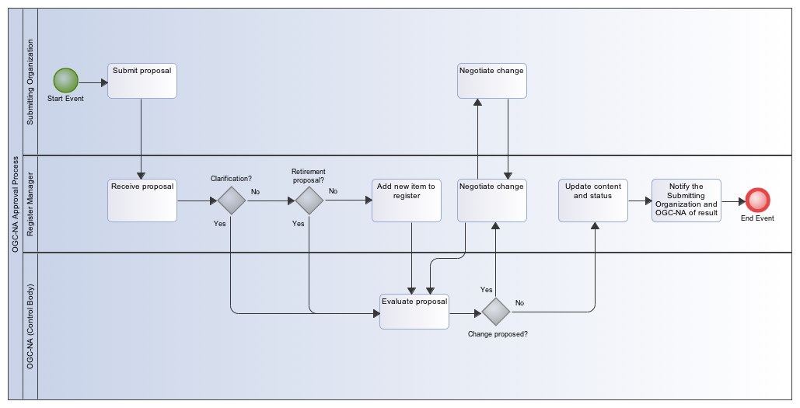
Registration Process

Slide 6
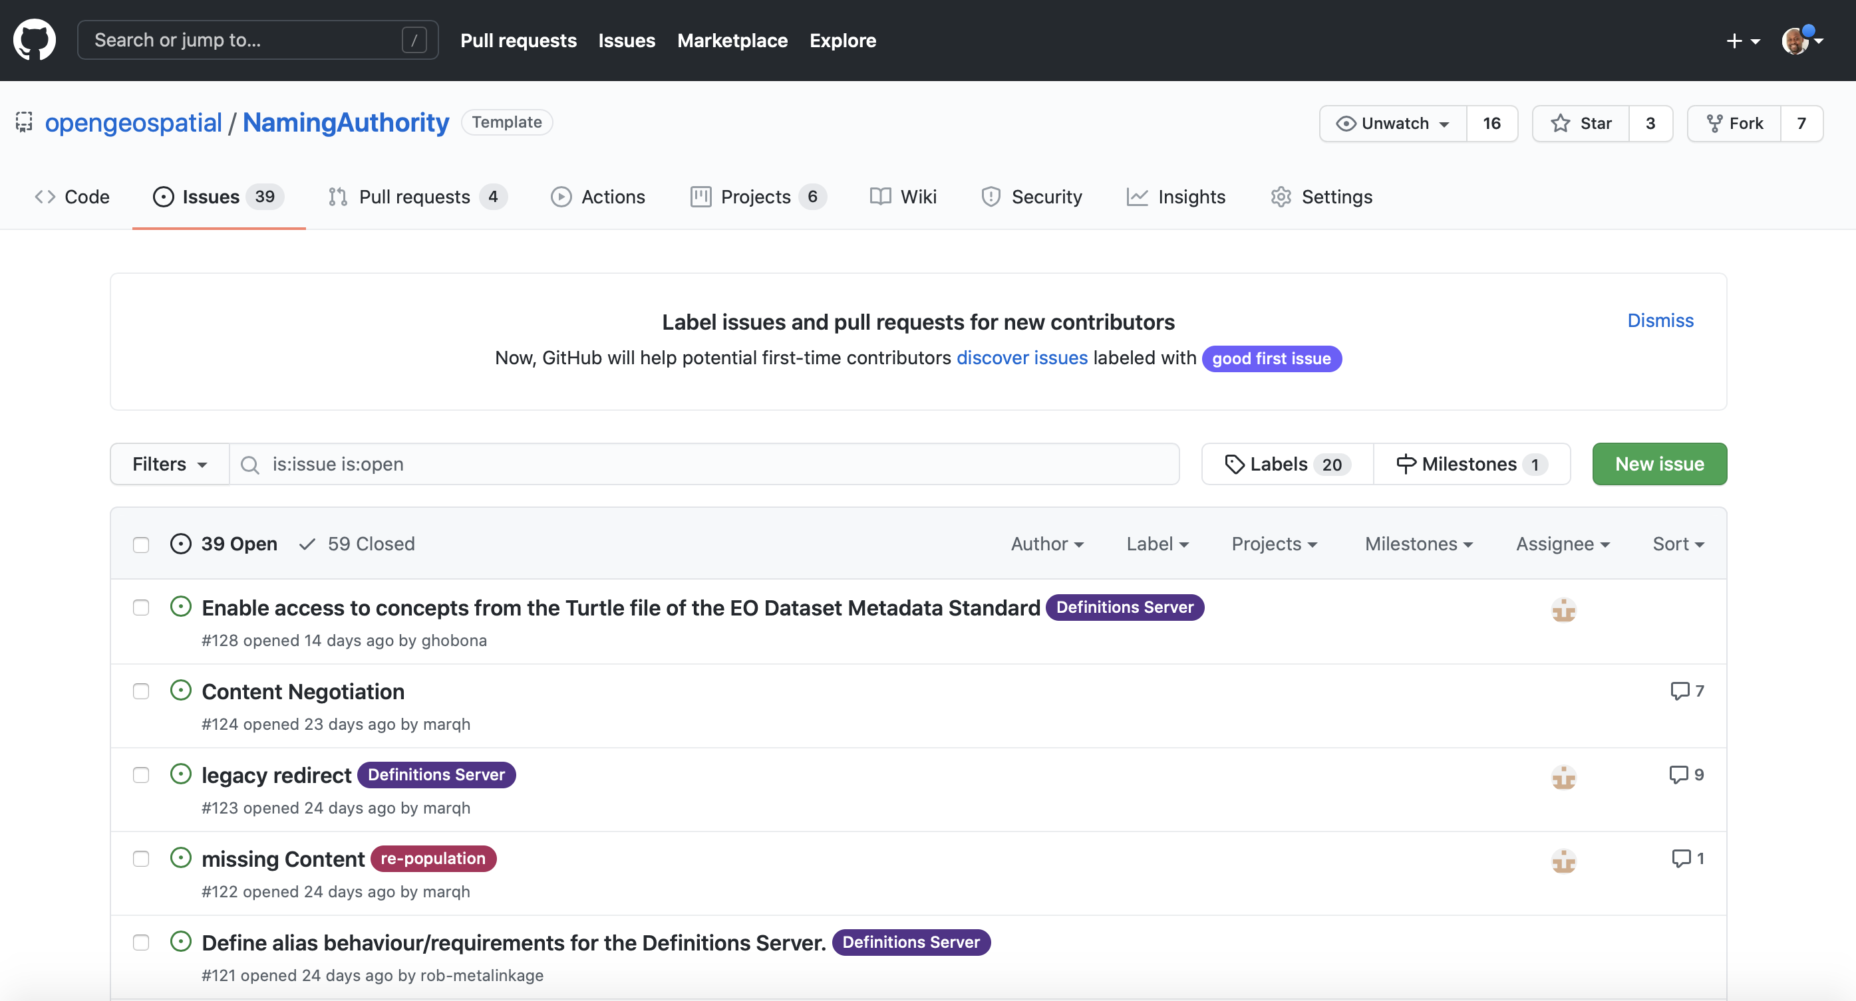
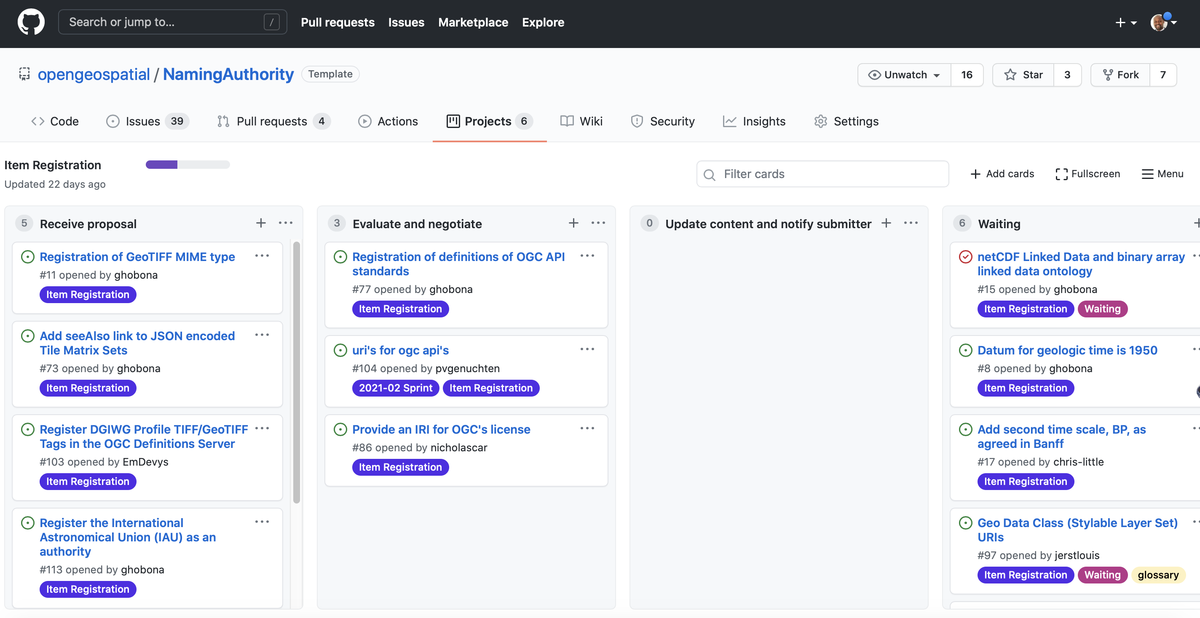
Where to Submit Proposals

Slide 7
An Introduction to the OGC Definitions Server
OGC APIs
Sensor Models
Parameters
Link relation types
CRS & Media Types
Definitions Server
Data Encodings
Standards & Profiles
CRS
Registers
Inference Engine
Cross references
Concept definitions
Content Management
CRS Resolver
Concept definitions
CRS
CRS
Media Types
OGC Web Services
Sensor Webs

Slide 8
Improved Automation
[Domain, ordered profile list]*
Git commits
Git Action
script
Linked
Data
(views and redirects)
entail
validate
Annotate conformance
serialize
Git commits
LOOP PER PROFILE PER “DOMAIN”
push
SHACL Profile
entailments
SHACL Profile validation rules
8

Slide 9
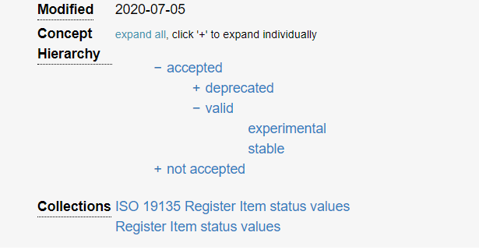
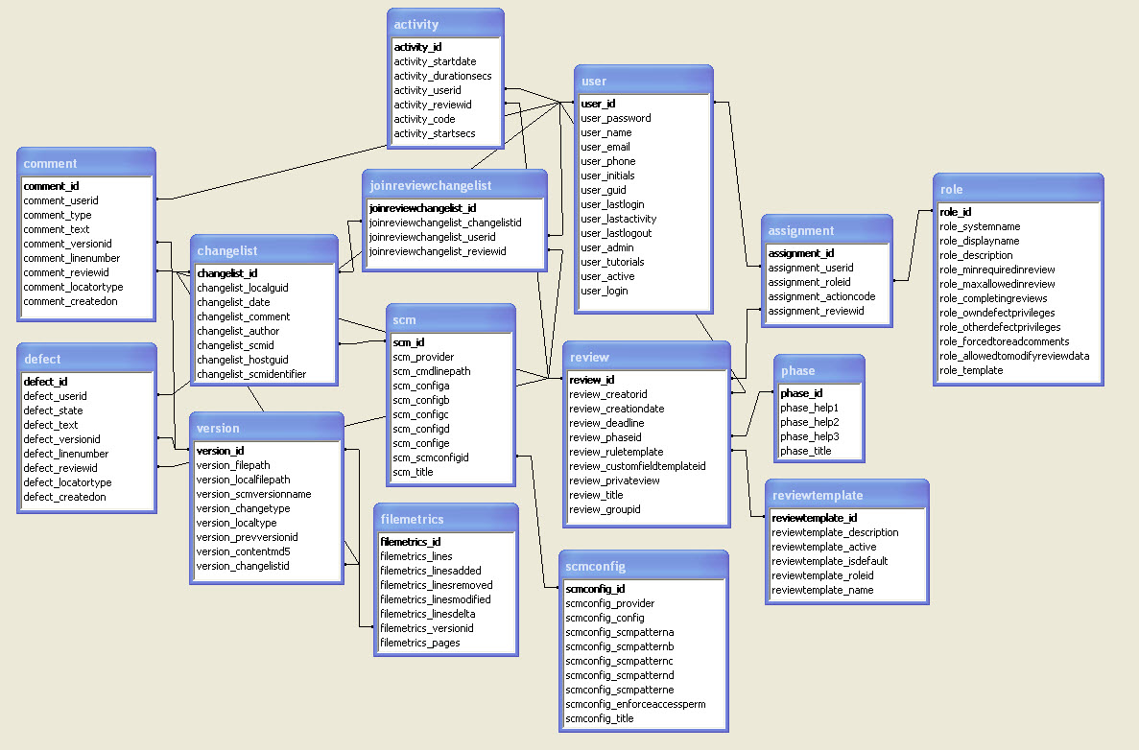
Improved Automation using profiles
Domains
(directories under GIT matching URI path roots.)
OGC NA profile
(governance metadata)
Basic SKOS
OGC SKOS profile
UI profile
ModSpec
Machine readable
OWL
Feature Model (19109 Application Schema)

Slide 10
Community
500+ International Members
110+ Member Meetings
60+ Alliance and Liaison partners
50+ Standards Working Groups
45+ Domain Working Groups
25+ Years of Not for Profit Work 10+ Regional and Country Forums
Innovation
120+ Innovation Initiatives
380+ Technical reports
Quarterly Tech Trends monitoring
Standards
65+ Adopted Standards
300+ products with 1000+ certified implementations
1,700,000+ Operational Data Sets Using OGC Standards
Contact info@ogc.org to schedule a meeting for an in-depth discussion with OGC staff and join our community today!
Notes:
If you have any questions, do not hesitate to reach out to OGC or schedule a follow-up. We’re working constantly to change the landscape of location information and want to help your organization get where it needs to go.

